Slide 1
Abstract Data Type
Data Structures.
Main Notions and Definitions.

Slide 2
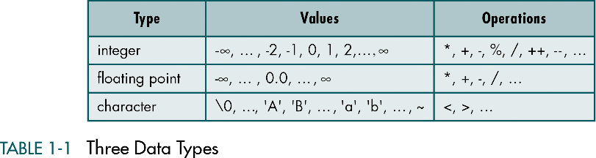
Atomic Data

Slide 3
Data Structure
A Data Structure is an aggregation of atomic and composite data into a set with defined relationships.
Structure means a set of rules that holds the data together.
Taking a combination of data and fit them into such a structure that we can define its relating rules, we create a data structure.

Slide 4
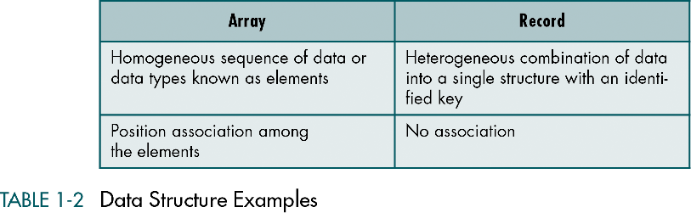
Composite Data Structures

Slide 5
Data Structure is:
A combination of elements in which each is either a data type or another data structure
A set of associations or relationships involving the combined elements

Slide 6
Data Structures: Properties
Most of the modern programming languages support a number of data structures.
In addition, modern programming languages allow programmers to create new data structures for an application.
Data structures can be nested. A data structure may contain other data structures (array of arrays, array of records, record of records, record of arrays, etc.)

Slide 7
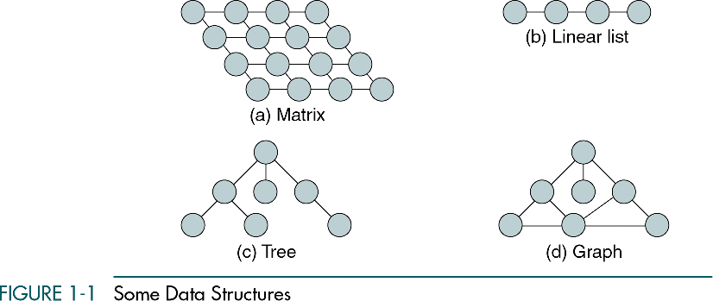
Some Data Structures

Slide 8
Pseudocode
Pseudocode is a pseudo programming language, which is commonly used to define algorithms
Pseudocode is a natural language-like representation of the algorithm logic
Its structure is close to the structure of the most high level programming languages, but it is free from many unnecessary details

Slide 9
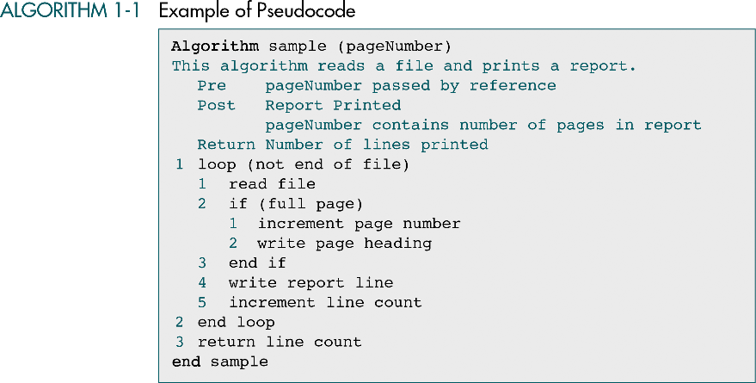
Data Structures: A Pseudocode Approach with C

Slide 10
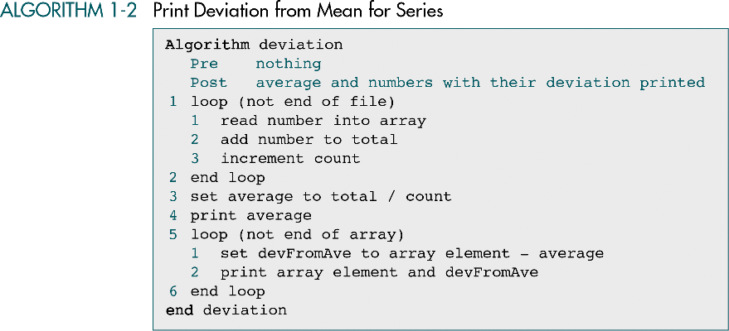
Data Structures: A Pseudocode Approach with C

Slide 11
The Abstract Data Type (ADT)
The concept of abstraction means:
We know what a data type can do
How it is done is hidden for the user
With an ADT users are not concerned with how the task is done but rather with what it can do.

Slide 12
ADT: Example
The program code to read/write some data is ADT. It has a data structure (character, array of characters, array of integers, array of floating-point numbers, etc.) and a set of operations that can be used to read/write that data structure.

Slide 13
The Abstract Data Type (ADT)
The Abstract Data Type (ADT) is:
A data declaration packaged together with the operations that are meaningful for the data type.
In other words, we encapsulate the data and the operations on the data, and then we hide them from the user.
Declaration of data
Declaration of operations
Encapsulation of data and operations

Slide 14
The Abstract Data Type (ADT)
All references to and manipulation of the data in a structure must be handled through defined interfaces to the structure.
Allowing the application program to directly reference the data structure is a common fault in many implementations.
It is necessary for multiply versions of the structure to be able to coexist.
We must hide the implementation from the user while being able to store different data.

Slide 15
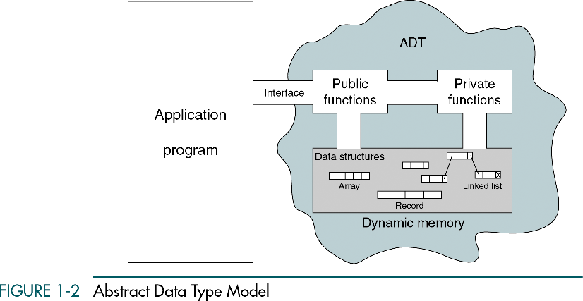

Slide 16
ADT Operations
Data are entered, accessed, modified and deleted through the external interface, which is a “passageway” located partially “in” and partially out of the ADT.
Only the public functions are accessible through this interface.
For each ADT operation there is an algorithm that performs its specific task.

Slide 17
Typical ADTs:
Lists
Stacks
Queues
Trees
Heaps
Graphs

Slide 18
1-4 ADT Implementations
There are two basic structures we can use to
implement an ADT list: arrays and linked lists.
In this section we discuss the basic
linked-list implementation.

Slide 19
Array Implementations
In an array, the sequentiality of a list is maintained by the order structure of elements in the array (indexes).
Although searching an array for an individual element can be very efficient, insertion and deletion of elements are complex and inefficient processes.

Slide 20
Homework
Assignments:
Q. 1 – What is Data Structure? Explain it.
Q. 2 – What is ADT? Explain ADT Model with an example.

Slide 21
Thank You...........!!!

